Slide 1
Making this resource work for you
Prior to teaching this lesson, please refer to the ‘Unit Overview and Planning Document’.
Further guidance on planning Science Mastery lessons can be found in the detailed planning guidance document.
Refer to the ‘notes’ section on each slide for useful information, including suggested expositions, pedagogical content knowledge, suggested questions, answers and more. Consider using presenter mode so you can see this guidance throughout the lesson.
The introduction slides can be adapted to suit your teaching style and the needs of your class.
Before the lesson, adapt the fix-it slide to address any misconceptions identified in the previous lesson’s exit ticket.
Choose from the suggested activities to suit your class. The intention is not that you complete all of these, but that you select those which ones are most appropriate for your students. It may be appropriate to further adapt activities for your students.
These lessons are designed to occupy approximately 1 hour. To adapt for a shorter or longer lesson duration we advise you to adapt the activity section accordingly.
Please consider using the final slide to send feedback about this lesson or examples of PowerPoints that you have adapted to our design team. Your feedback is used to improve Science Mastery for all of our teachers and students. We appreciate all suggestions and comments.
Thank you for reading!
The Science Mastery Team

Slide 2
How Humans Can Preserve Biodiversity
Answer the following questions:
State the definition of biodiversity.
State the definition of an ecosystem.
Why is high biodiversity important for an ecosystem?
Identify three resources that plants compete for.
Round 34928 to three significant figures.
The variety of different species in an ecosystem.
The interaction of a community of organisms with the non-living parts of their habitat.
Each species is not dependent on just one other species.
Sunlight, space, water, minerals.
34900
Notes:
Purpose: to assess learning at the beginning of the new unit and interleave key prior knowledge from B1.3.
Foundation question: Explain the difference between a habitat and an ecosystem.
Answer: A habitat is the place where an organism lives but an ecosystem refers to the interaction of the community of organisms with the non-living parts of their environment (all the factors in their habitat).
Stretch question: Explain how the introduction of a non indigenous species can affect biodiversity in an area.
Answer: Introducing non-indigenous species can reduce biodiversity if the species out-competes or kills indigenous species

Slide 3
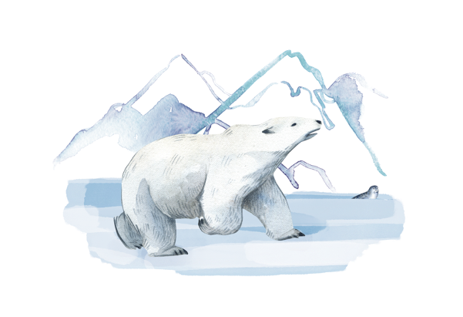
B3.2.4
11/02/2025
How Humans Can Preserve Biodiversity
B3.2.1 Prior Knowledge Review
B3.2.2 Biodiversity
B3.2.3 How Humans Affect Biodiversity
B3.2.4 How Humans can Preserve Biodiversity
B3.2.5 The Effect of Pollution on Biodiversity
B3.2.6 Global Warming
B3.2.7 Taking It Further: Pyramids of Biomass
B3.2.8 Taking It Further: Farming and Biotechnology
B3.2.9 Taking It Further: Food Security
Notes:
Big Idea: Organisms are Interdependent
Pupils have previously learnt about biodiversity and the negative effects humans can have on it. In this lesson pupils will learn about the things people can and are doing to preserve biodiversity around the world and try to prevent many endangered species from going extinct.
Suggested Hook:
Last lesson we looked at ways in which humans can affect biodiversity in a negative way. Some of these ways have led to species becoming extinct. What are some examples of species that have become extinct? Any example- dodo, sabre tooth tiger, mammoth and more recently West African Black Rhino (2011), Pinta Tortoise (2012), Madagascan Hippopotamus (2014). It is important that as humans we do not allow many more species the become extinct therefore we need to make the effort to maintain biodiversity rather that decrease it. How can we do that and what is currently being done by all different types of people from scientists to farmers to governments and industries? Let’s find out…

Slide 4

Following this lesson, students will be able to:
State that the growth of the human population has increased demand for resources
Describe how scientists and citizens can reduce human impact on biodiversity
Evaluate whose responsibility it is to reduce human impact on the environment
Key Words:
biodiversity
population
resources
Notes:
Can be edited depending on class need.

Slide 5
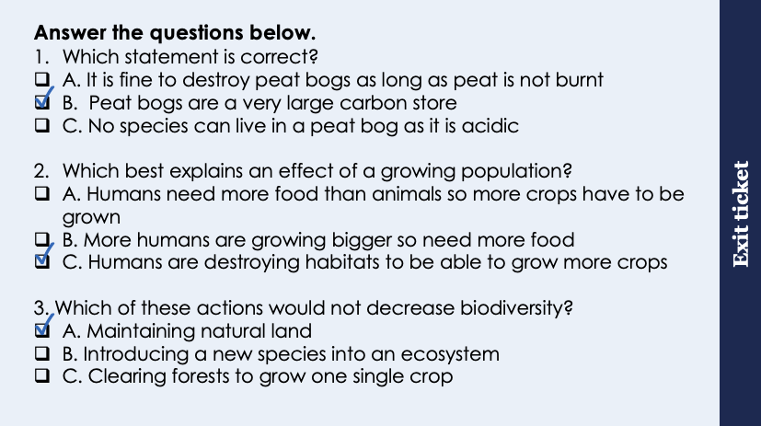
This is the fix-it portion of the lesson
The fix-it is an opportunity to respond to gaps in knowledge, especially those identified by the previous lesson’s exit ticket.
The teacher should customise this slide as needed, to facilitate
reteach, explanation, demonstration or modelling of ideas and concepts that students have not yet grasped or have misunderstood.
practise answering specific questions or of key skills.
redrafting or improving previous work.
Notes:
Purpose: to spend time on any gaps identified in previous learning from exit ticket feedback.
Fix it guidance from previous exit ticket:
Q1. Answer: B
If students answer A or B, they do not fully appreciate what a peat bog is. To fix-it, it may be useful to show a large photo of a peat bog to show the organisms that can live there even in the acidic conditions and therefore if the peat is destroyed habitats are also destroyed.
Q2. Answer: C
If students answer A or B, they have either overestimated the importance of humans (i.e. that we are more important than other species) or they have misunderstood the term growing population. To fix-it revise the idea that more people need more resources and produce more waste, rather than people themselves are actually growing taller.
Q3. Answer: A
If students answer B or C, they may not have linked the cause from the answer with the effect of reducing biodiversity. To fix-it go through each example and get pupils to state if it would benefit or potentially harm the organisms already living there. For example B ask them to identify the reasons a new species could harm other organisms living there (from slide 7). An example of an invasive plant species such as Japanese Knotweed could also be introduced.

Slide 6
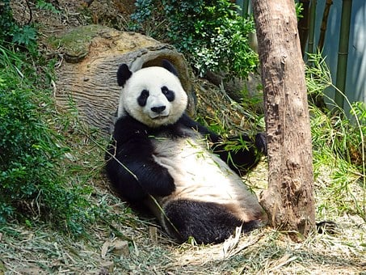
Human Effects on Biodiversity
Scientists and many global citizens are using various methods to try to reduce human impact on biodiversity:
Breeding programmes for endangered species
Rare habitat protection
Reducing deforestation
Recycling resources to reduce landfill waste
Growing hedgerows on farms
Notes:
Purpose: introducing new knowledge
Exposition Type: Explanation
Suggested Script:
Many people across the world are trying to prevent biodiversity from decreasing any further. One way or doing this is identifying the species that are most at risk of extinction and helping them repopulate. Can you name any species that have already gone extinct or species that are at risk of going extinct? Any example of an extinct species, some examples of species at risk of going extinct are: Sumatran orangutan, red tuna, mountain gorilla, leatherback turtles, pitcher plant, corpse flower.
Breeding programmes can have different effects on biodiversity depending on the type of programme. Breeding programmes for endangered species are very useful to manage and maintain species populations, these will therefore help maintain biodiversity. However selective breeding programmes will have a negative effect on biodiversity as it reduces genetic variation. Breeding programmes for endangered species are often carried out in zoos or controlled environments with the aim of introducing the animals to the wild. Some the Zoological Society London have been involved with breeding programmes for the Amur leopard, Amur tiger and gazelles. Restoring populations to a sustainable level with breeding programmes can be difficult because many rare animals and plants do not reproduce quickly and breeding programmes need to be arranged to prevent inbreeding.
Habitat protection – this includes nature reserve areas being granted further protection and stricter regulations on land usage. Coral reefs and mangroves are examples of habitats that are being protected worldwide.
Remind me from our previous lesson, what is deforestation? Deforestation is when forests are cleared to make space for farming, both for animals such as cattle and for crops such as rice this happens particularly in Brazil where large parts of the Amazon are being destroyed to stimulate the economy by providing more resources.
Recycling- Do you recycle at home, if so what kinds of materials do you recycle? Likely plastic, paper/card, tins, glass. It may be an interesting discussion for pupils to have about how resources can be reused and reduced rather than recycled. It is very useful to have materials that can be recycled, but this process also requires a lot of energy and not all materials can be reduced.
Hedgerows- Years ago many farmers removed hedgerows between fields so they could plant huge fields with only one type of crop to increase yield. This removed habitats for many birds, insects, plants and mammals reducing biodiversity. Now many farmers are reintroducing hedgerows as well as margins around fields for wildflowers to grow thus creating new habitats and increasing biodiversity. Why would it be beneficial to farmers to increase the insect biodiversity on there farms? Think back to our Y7 unit when we learnt about plant reproduction. Insect pollination would increase so crop plants would reproduce more.
Info on breeding programmes here: : https://www.zsl.org/conservation/how-we-work/conservation-breeding
Image from pixabay

Slide 7
True or false?
An example of a rare habitat that is protected is a coral reef
Reintroducing hedgerows on farms decreases biodiversity
All breeding programmes always increase biodiversity
Deforestation is planting new trees to increase biodiversity
True
False - increases biodiversity because it provides a habitat for many different species
False - selective breeding programmes will decrease biodiversity as they reduce genetic variation in a population
False - deforestation is cutting down trees (for farming, building, etc) which reduces biodiversity
Notes:
Purpose: review of new information.
These questions can be edited depending on the information you would like pupils to focus on.
Answers:
True
False- increases biodiversity because it provides a habitat for many different species
False - selective breeding programmes will decrease biodiversity as they reduce genetic variation in a population
False – deforestation is cutting down trees (for farming, building, etc) which reduces biodiversity

Slide 8




Which statements do you agree with?
The government of each country should be responsible for making people produce less waste
One person cannot make a difference to waste, there is nothing I can do
All countries are equally responsible for reducing biodiversity
Companies should not be allowed to sell single use plastics
Notes:
This talk task can be used to generate opinions and a debate about whose responsibility it is to reduce human impact on the environment.
Suggested guidance:
Talk tasks can be used in a variety of ways to suit the particular needs of the students you are teaching. Through exchanging views with others, students develop their understanding of the science beyond what could be achieved individually.
Science classrooms that successfully integrate talk have the following features:
Science talk is a regular feature of lessons and is woven into classroom activities.
Students are paired or grouped strategically by the teacher to ensure productive interaction. This might take into consideration the students’ proficiency of the English language, how encouraging they might be to peers and their attainment in the topic. It’s a good idea to consider these pairings in the class seating plan.
Students are encouraged and supported to talk, but are not forced to talk.
The teacher should take on the role of a facilitator, engaging with conversations where necessary and encouraging or steering the conversation where needed.
Students are encouraged to use the language they have to express their ideas (e.g., everyday language, imperfect English, native language), but also to incorporate science specific terminology where this is more accurate or has been taught.
6. Scientifically inaccurate ideas are not dismissed by the partner or teacher; open discussion and further investigation are relied on to help students construct ideas that support them to progress in their scientific understanding.
7. Guidelines for behaviour during talk tasks are explicit and frequently reviewed. Rules for students might be:
Listen carefully to your partner
Take turns talking.
Speak one at a time, without interrupting.
Politely agree or disagree and explain why.
Politely point out if your partner has used a scientific word incorrectly, if they have explained the science incorrectly, or if there is a more accurate way to describe something.
If confused, ask questions.
Stay focused on the discussion topic.
Respond to one another.

Slide 9
Drill
Why has the demand for resources increased?
State why crop farming can reduce biodiversity.
State one thing farmers can do to improve biodiversity.
State one thing zoos can do to improve biodiversity.
State two other actions humans can take to improve biodiversity.
State one way deforestation can increase carbon dioxide levels in the atmosphere.
State one factor that may cause a plant species to become extinct. Do not refer to deforestation in your answer.
Notes:
Purpose: This is a knowledge drill. The purpose of this is to check that the critical knowledge is secure before pupils move onto independent practice.
Suggested guidance: There are a range of ways this could be done depending on time and ability range of the class:
Mini whiteboards
As full sentences in exercise books
As short answers in exercise books
In the pupil workbook
As pair talk
As cold call

Slide 10
Drill answers
Growth of the human population
As farmers use the same crop, reducing the gene pool
Growing hedgerows on farms
Breeding programmes for endangered species, rare habitat protection
Reducing deforestation, recycling resources to reduce landfill waste.
Less photosynthesis
Disease, predator, competitor
Notes:
Purpose: This is a knowledge drill. The purpose of this is to check that the critical knowledge is secure before pupils move onto independent practice.
Suggested guidance: There are a range of ways this could be done depending on time and ability range of the class:
Mini whiteboards
As full sentences in exercise books
As short answers in exercise books
In the pupil workbook
As pair talk
As cold call

Slide 11

I: Describe: to recall facts, events or processes in an accurate way
Describe the effect of protecting rare habitats on biodiversity.
To ‘describe’, your answer should:
Use bullet points.
Include each step of the process in a logical order.
Use keywords throughout the answer
Stay focused on the question.
Model answer:
Protecting rare habitats allows habitats to regenerate and conserves space for organisms to live
This increases biodiversity
Notes:
This slide models the process of answering a describe question.
Firstly, students are presented with a generic describe question, along with a model answer. Students are also given some simple guidance to follow for producing their own describe answer.
The generic question and answer should be used by the teacher to remind students of
the key features of a great answer
how to structure their answer
why the model answer is a good example
Following this, students will be required to apply this process to answer their own describe question, which will appear in place of the generic questions. This describe question will be specific to the topic students are learning about in the lesson. Give students time to write their own answer to this, ensuring that they use the guidance provided. To further scaffold this task for students, it may be appropriate to:
pair students up to write an answer together
list for students the key words you would like them to include in the answer
provide a writing frame or ‘points to include’ for students
A model answer for this question will appear. Teachers should review the model answer with students by referencing the guidance in the green box. For example ‘we can see item 1 in the guidance is to use bullet points to keep your answer clear. Notice in the model answer here we have done just that’. Or ‘item 2 in the guidance here says that we should use scientific keywords in the answer. Has this been achieved in the model answer? Where can we see this?’.

Slide 12
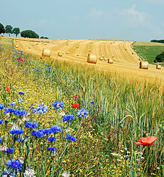
We: Describe: to recall facts, events or processes in an accurate way
Describe the effect of introducing hedgerows on biodiversity.
To ‘describe’, your answer should:
Use bullet points.
Include each step of the process in a logical order.
Use keywords throughout the answer
Stay focused on the question.
Model answer:
Introducing hedgerows gives organisms new habitats to live in
This increases biodiversity
Notes:
This slide models the process of answering a describe question.
Firstly, students are presented with a generic describe question, along with a model answer. Students are also given some simple guidance to follow for producing their own describe answer.
The generic question and answer should be used by the teacher to remind students of
the key features of a great answer
how to structure their answer
why the model answer is a good example
Following this, students will be required to apply this process to answer their own describe question, which will appear in place of the generic questions. This describe question will be specific to the topic students are learning about in the lesson. Give students time to write their own answer to this, ensuring that they use the guidance provided. To further scaffold this task for students, it may be appropriate to:
pair students up to write an answer together
list for students the key words you would like them to include in the answer
provide a writing frame or ‘points to include’ for students
A model answer for this question will appear. Teachers should review the model answer with students by referencing the guidance in the green box. For example ‘we can see item 1 in the guidance is to use bullet points to keep your answer clear. Notice in the model answer here we have done just that’. Or ‘item 2 in the guidance here says that we should use scientific keywords in the answer. Has this been achieved in the model answer? Where can we see this?’.
Image source:
CC@https://commons.wikimedia.org/wiki/Field#/media/File:Field_Hamois_Belgium_Luc_Viatour.jpg

Slide 13
You: Describe: to recall facts, events or processes in an accurate way
Describe the different actions humans can take to help maintain biodiversity.
To ‘describe’, your answer should:
Use bullet points.
Include each step of the process in a logical order.
Use keywords throughout the answer
Stay focused on the question.
People can run, take part in or fund breeding programmes for endangered species.
Humans can protect rare habitats such as mangroves and coral reefs to enable the habitats to regenerate.
Governments and industries can reduce deforestation which will protect habitats and maintain biodiversity in the area.
People at home can reuse and/or recycle resources to reduce landfill waste
Farmers can reintroduce hedgerows on their farms to provide new habitats and increase biodiversity.
Notes:
This slide models the process of answering a describe question.
Firstly, students are presented with a generic describe question, along with a model answer. Students are also given some simple guidance to follow for producing their own describe answer.
The generic question and answer should be used by the teacher to remind students of
the key features of a great answer
how to structure their answer
why the model answer is a good example
Following this, students will be required to apply this process to answer their own describe question, which will appear in place of the generic questions. This describe question will be specific to the topic students are learning about in the lesson. Give students time to write their own answer to this, ensuring that they use the guidance provided. To further scaffold this task for students, it may be appropriate to:
pair students up to write an answer together
list for students the key words you would like them to include in the answer
provide a writing frame or ‘points to include’ for students
A model answer for this question will appear. Teachers should review the model answer with students by referencing the guidance in the green box. For example ‘we can see item 1 in the guidance is to use bullet points to keep your answer clear. Notice in the model answer here we have done just that’. Or ‘item 2 in the guidance here says that we should use scientific keywords in the answer. Has this been achieved in the model answer? Where can we see this?’.

Slide 14
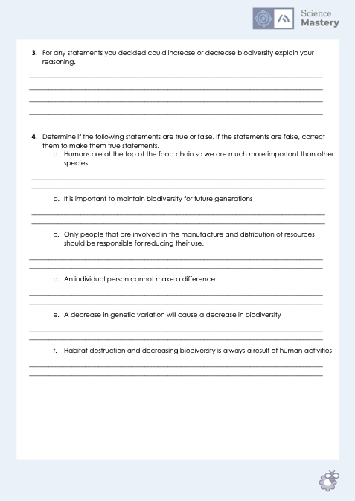
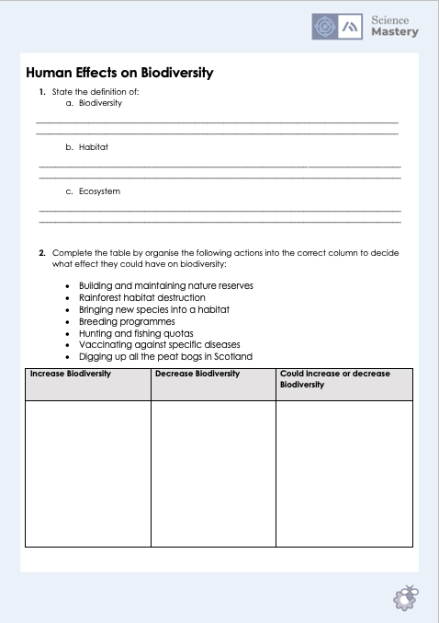
How Humans Can Preserve Biodiversity
Complete the worksheet
Notes:
Purpose: practice application of new information
This resource can be used as an independent worksheet but could be to use to foster discussion and debate through pair or group work.
**Q4 in particular can be used as a whole class activity, where the statement is written on the board or a piece of paper in the middle of the room and pupils have to line up based on how confident they are that it is true or false (and pupils across the spectrum can be questioned about why they have stood in that position).**

Slide 15
Answer the questions below.
Which of the following is not a way to maintain biodiversity?
A. Protecting rare habitats
B. Selective breeding programmes
C. Reducing deforestation
2. Why would a farmer grow hedgerows on their farm?
A. To use hedgerows as crops to sell
B. To increase crop yield by making more space
C. To increase biodiversity
3. Which of these actions would increase biodiversity?
A. Maintaining nature reserves
B. Introducing a new species into an ecosystem
C. Using a selective breeding programme to produce more individuals with a desired characteristic
✓
✓
✓
Notes:
Q1. Answer: B
If students answer A or C, they have selected a way to maintain biodiversity, they may have fallen for the breeding programme. To fix-it briefly ask pupils what selective breeding means. Selecting for a genetic trait will reduce variation so reduce biodiversity. Breeding programmes that are for endangered species are different to selective breeding programmes.
Q2. Answer: C
If students answer A, they may have the misconception that hedgerows are crops, rather than a way to increase biodiversity by providing habitats for animals. If they answer B, this suggests a confusion of why hedges were originally removed as compared to growing them to increase biodiversity. To fix-it model a hedgerow on the board and ask pupils to explain why it would increase biodiversity- new species of plants and new habitats for insects and small animals.
Q3. Answer: A
If students answer A or B, they have not identified a way to increase biodiversity. To fix-it they may find it useful to be given more statements and sort these into increase/decrease biodiversity, similar to the question on the worksheet for this lesson. You may also want to get them to explain their reasoning for sorting statements so you can further identify where their misconceptions lie. Most likely they have chosen B and assumed that another species is always going to increase biodiversity – it may be useful to illustrate with a food web how this may not always be the case (e.g. where a stronger competitor outcompetes another and causes the weaker species to become endangered and decreases the amount of resources/food available).

Slide 16
Lesson B3.2.4
What was good about this lesson? | What can we do to improve this lesson?
Send us your feedback by clicking this link
or by emailing sciencemastery@arkonline.org
Thank you!

